Slide 1

TELCO-CUSTOMER CHURN ANALYSIS
Presented by:
P. Sridhar
B. Naveen
Batch : 450
Innomatics Research
Labs, Dilsuknagar

Slide 2
ABOUT ME
www.linkedin.com/in/Vanity URL name
I am PUTNALA SRIDHAR
I Completed my graduation in the stream of B.sc (MSDS) and Degree from Govt degree college of khairatabad.
Linkedin : https://www.linkedin.com/in/putnala-sridhar-067077370/
I am B.Naveen
I Completed my graduation in the stream of Btech (ECE) From Siddhartha Institute of Engineering and Technology in Ibrahimpatnam
Linkedin : https://www.linkedin.com/in /bairi-naveen-79a09a330

Slide 3

AGENDA
Business Problem
Problem Statement
Objectives
Dataset Overview
Data Preparation & Cleaning
Dashboard Visualizations
Applications & Recommendations
Conclusion & Future Scope

Slide 4
Business Problem
Problem: Telecom companies are losing customers due to high churn
Impact: Customer churn leads to revenue loss and higher costs to acquire new customers.
Need: Businesses must analyze customer data to identify churn drivers and take proactive retention actions.

Slide 5
PROBLEM STATEMENT
Customer churn is a major challenge in the telecom industry, where customers frequently switch service providers due to pricing, service quality, contract flexibility, or payment issues.
Raw data analysis is required to identify high-risk customers and take proactive actions to reduce attrition and improve profitability.

Slide 6
OBJECTIVES
To analyze customer churn behavior in a telecom company
Understand key drivers influencing customer churn.
To visualize churn patterns using interactive Power BI dashboards
To support business decisions for customer retention strategies.
To reduce revenue loss and improve customer satisfaction and profitability.

Slide 7
DATASET OVERVIEW
Dataset Name: Telco Customer Churn Dataset
Source: CSV file
Total Records: 7,043 customers
Key Columns:
  CustomerID
  Gender, SeniorCitizen
  Tenure
  Internet Service, Phone Service
  Contract Type
  Payment Method, Paperless Billing
  Monthly Charges, Total Charges
  Churn

Slide 8
DATA PREPARATION & CLEANING
Imported CSV dataset into Power BI
Removed duplicate and irrelevant columns
Normalized Column Datatypes
Handled missing and null values
Created calculated measures using DAX:
  Churn Rate %
  Average Monthly Charges
  Retained Revenue & Lost Revenue
  Customer Segmentation by Tenure
  Created tenure segments for better analysis

Slide 9
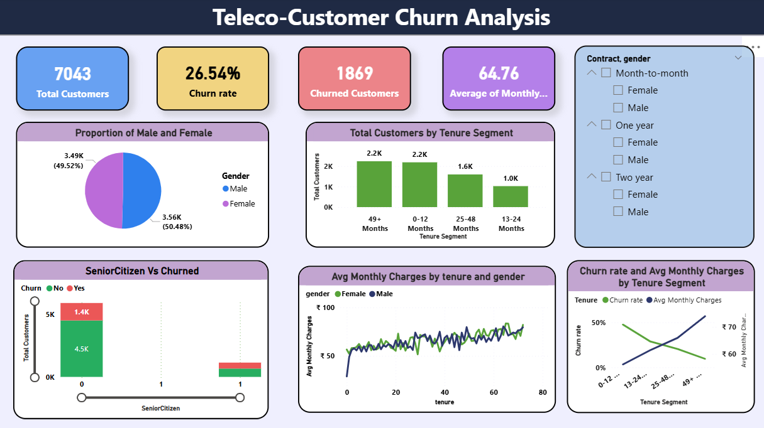

Slide 10
1. CUSTOMER DEMOGRAPHICS ANALYSIS
Purpose:
To understand customer distribution, churn behavior across gender and age groups, and how tenure impacts customer retention.
Key Insights:
New customers (0–12 months) show higher churn, while long-term customers are more stable.
Senior citizens show higher churn percentage compared to Non-senior customers are more likely to stay.
Monthly charges increase with tenure where Male and female charges follow a similar pattern

Slide 11
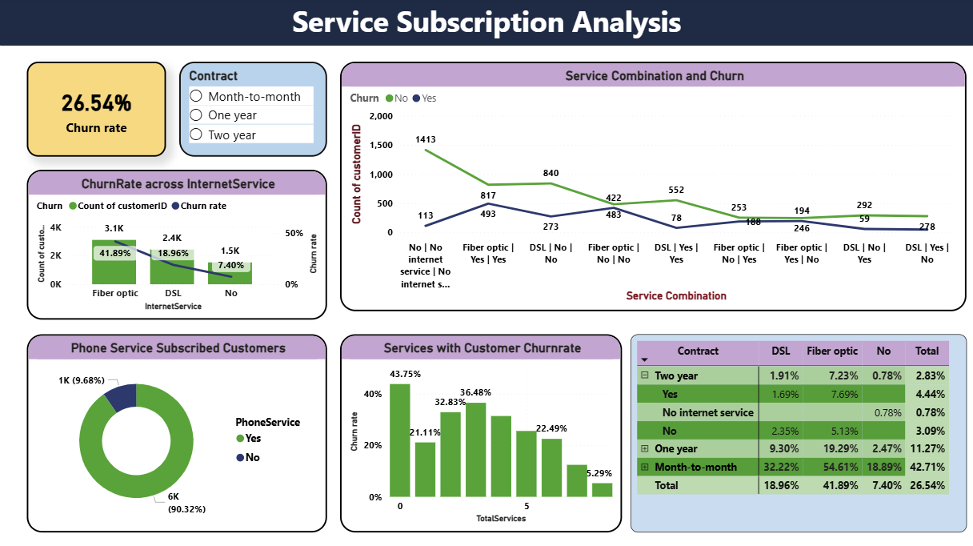

Slide 12
2. SERVICE SUBSCRIPTION ANALYSIS
Purpose:
To analyze how different services and service combinations influence customer churn.
Key Insight:
Fiber optic customers have the highest churn rate, while customers with multiple services churn less.
Month-to-month + Fiber optic customers have the highest churn combination, whereas long-term contracts reduce churn across all services.
Phone service alone does not significantly drive churn, as most customers already subscribe to it.

Slide 13
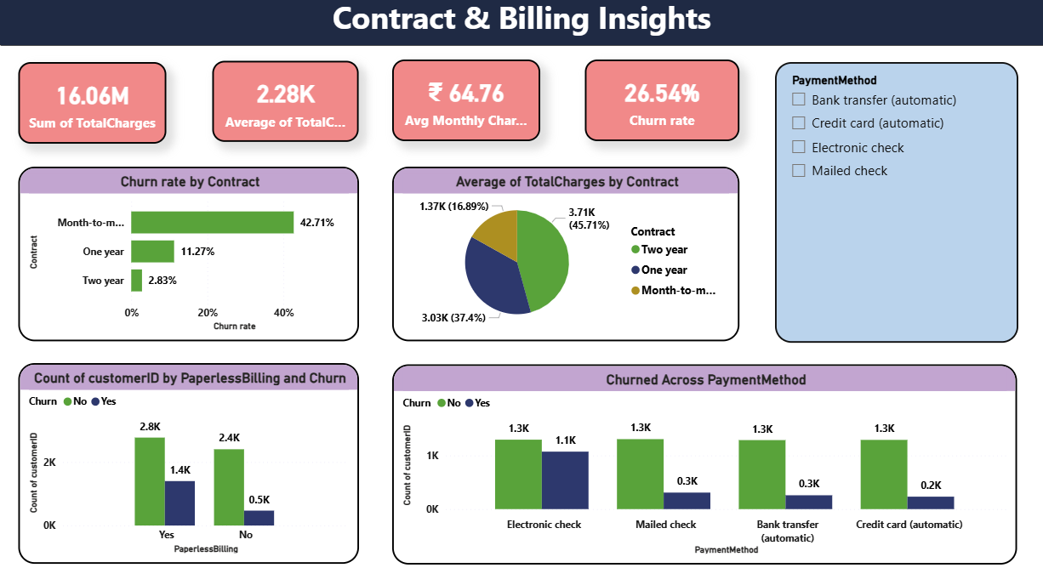

Slide 14
3. CONTRACT & BILLING INSIGHTS
Purpose:
To evaluate how contract duration, billing type, and payment methods affect churn behavior.
Key Insights:
Customers on month-to-month contracts leave the most, while two-year contracts retain customers better.
Customers using electronic check payments churn more, while auto-pay methods are more stable.
Long-term contract customers pay more and stay longer, making them the most valuable customers.

Slide 15
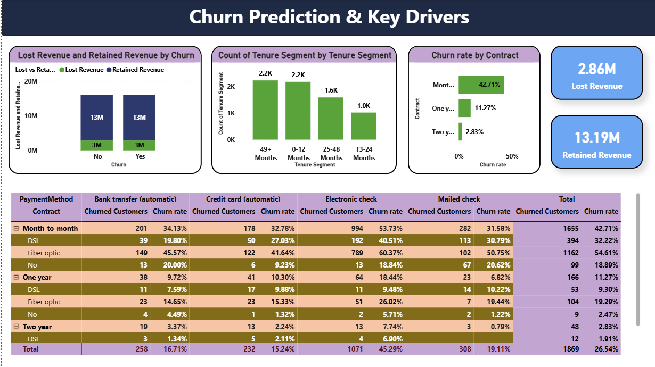

Slide 16
4. CHURN PREDICTION & KEY DRIVERS
Purpose:To identify high-risk customers and key drivers contributing to revenue loss
Key Insight:
Month-to-month contract customers have the highest churn rate, while long-term contracts (1-year and 2-year) show much better retention.
Customers using electronic check as a payment method churn significantly more than those using other payment options.
Customers with short tenure (0–12 months) are more likely to churn compared to long-tenure customers

Slide 17
APPLICATIONS
Helps telecom companies identify high-risk customers
Supports targeted retention campaigns
Improves pricing and contract strategy decisions
Enhances revenue forecasting and planning

Slide 18
CONCLUSION & FUTURE SCOPE
Conclusion
Future Enhancements
Customer churn has a significant impact on revenue and long-term business growth.
Analysis reveals that contract type, tenure, monthly charges, and service usage are the key drivers of churn.
Predictive insights and dashboards help identify high-risk customers early and drive targeted actions to reduce churn and increase profitability.
Integrate machine learning churn prediction models
Include real-time customer behavior data
Perform customer lifetime value (CLV) analysis
Build mobile-optimized dashboards

Slide 19
Recommendations
Encourage long-term contracts with discounts
Improve service quality for fiber optic users
Promote auto-pay and paperless billing incentives
Focus retention strategies on new customers

Slide 20


Slide 21

THANK YOU

